Slide 1
Ethical Hacking Internship Task 3
By- aashutosh sharma

Slide 2
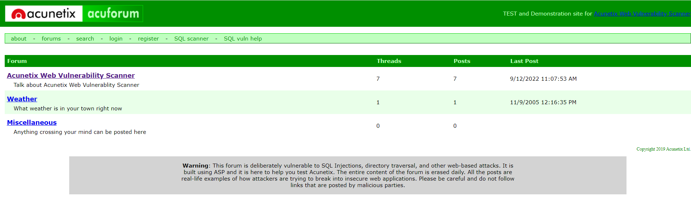
Objective
To prepare a report on a vulnerability found on the website http://testasp.vulnweb.com/ .
Site view –

Slide 3
The Vulnerability
Vulnerability Name - SQL injection vulnerability allowing login bypass
Vulnerability Description – This vulnerability implies a threat to the site security by SQL Injection Attack. Any hacker may bypass the main authorization page or login page by typing combination of some characters with sql syntax in a particular sequence as username and a random password. Hacker can also gain access to the sensitive information which can be only accessed by the user or admin of the site by using this attack. So that’s why it is essential to mitigate such type of attacks and ensure better site safety.

Slide 4
Procedure Used
1. Open the main page of the website http://testasp.vulnweb.com/.

Slide 5
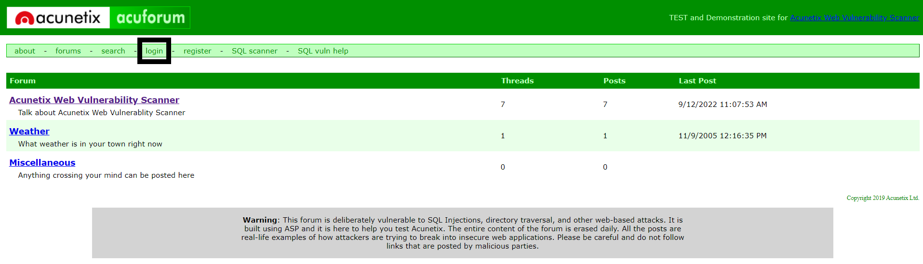
2. Go to the login option on the dashboard

Slide 6
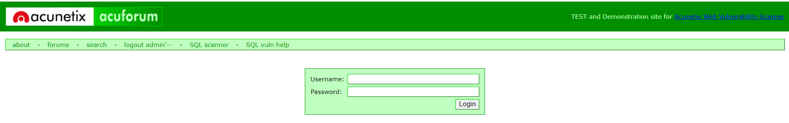
3. A login page will be opened

Slide 7
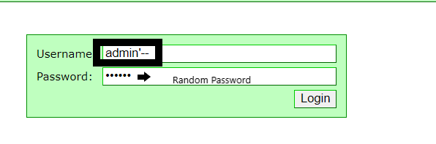
4. Enter “ admin’—” as username and a random password then click login.

Slide 8
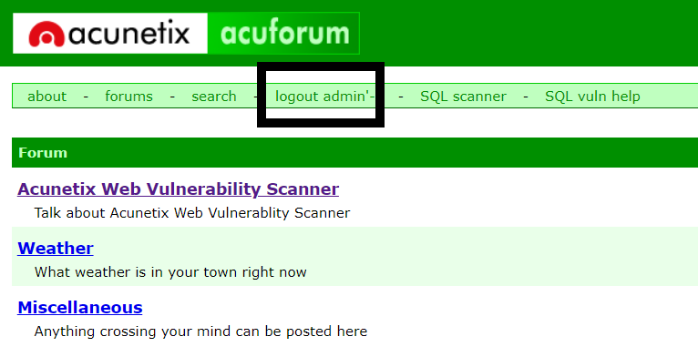
Result
We will find that the website will be successfully logged in by just using a sequence of characters as username and a random Password.

Slide 9
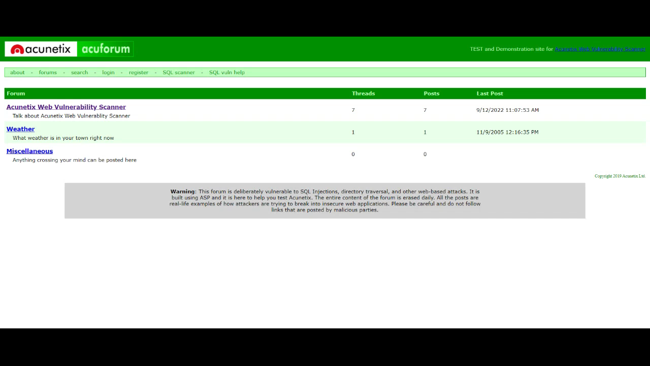
Procedure Video

Slide 10
Mitigation Steps
Authenticate each application resource.
Manage session cookies appropriately.
Take extra care while validating authentication parameters to prevent SQL injection attacks. Use parameterized SQL queries or DB stored procedures for database calls.

Slide 11


